Slide 1


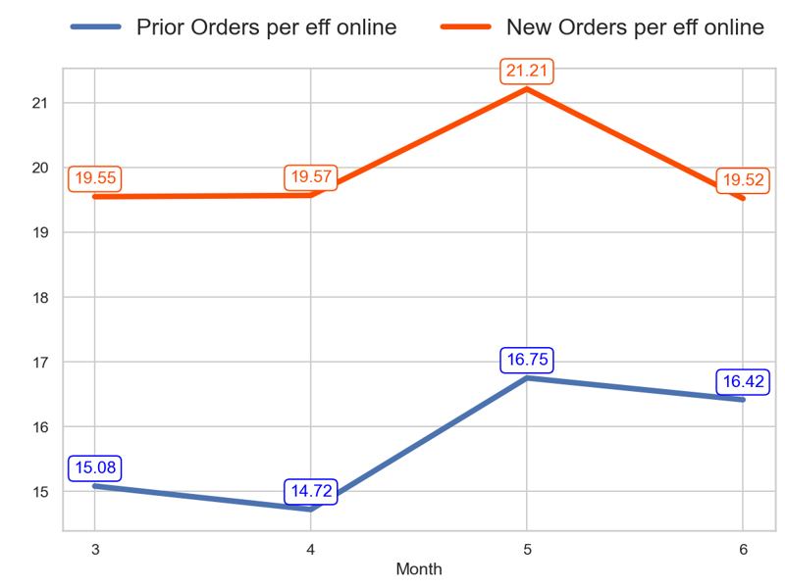
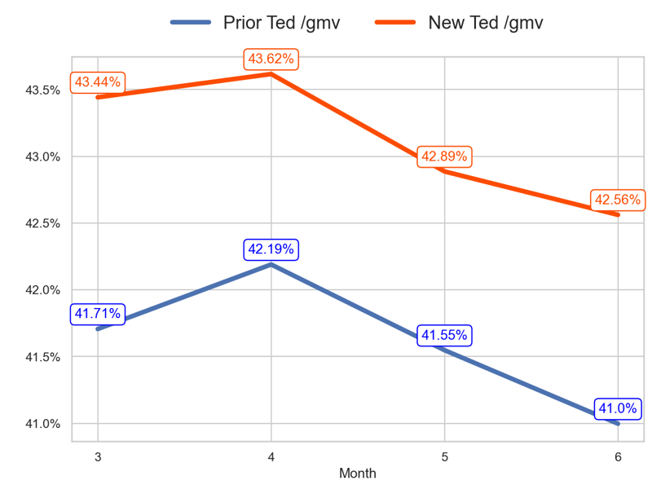
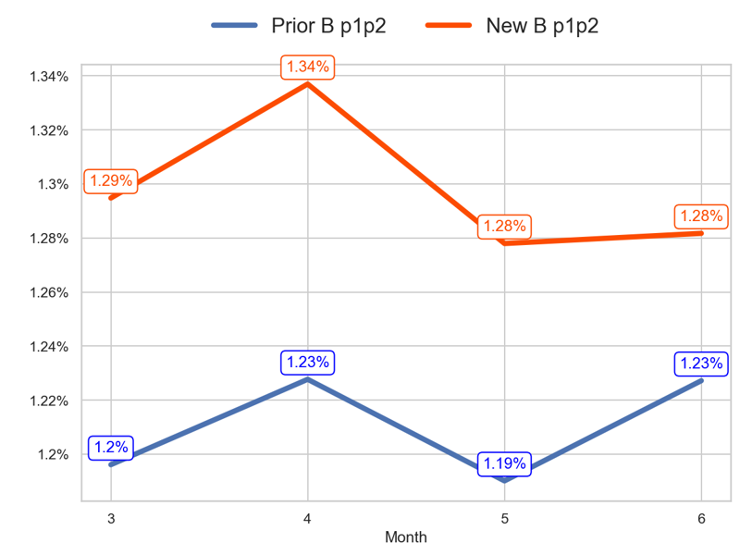
PERFORMANCE
Action Title
Prior P2 vs New P1 -
Insights
- The new priority has a worse tendency than the old one over the last 3 months (-0.14% < 8.83%) - The last 3 months mean of the old priority is 15.96 and the new priority is 20.1
- The new priority has a worse tendency than the old one over the last 3 months (-0.88 < -0.71 percentage points) - The last 3 months mean of the old priority is 41.58% and the new priority is 43.02%
- The new priority has a worse tendency than the old one over the last 3 months (-0.01 < 0.03 percentage points) - The last 3 months mean of the old priority is 1.22% and the new priority is 1.3%

Slide 2
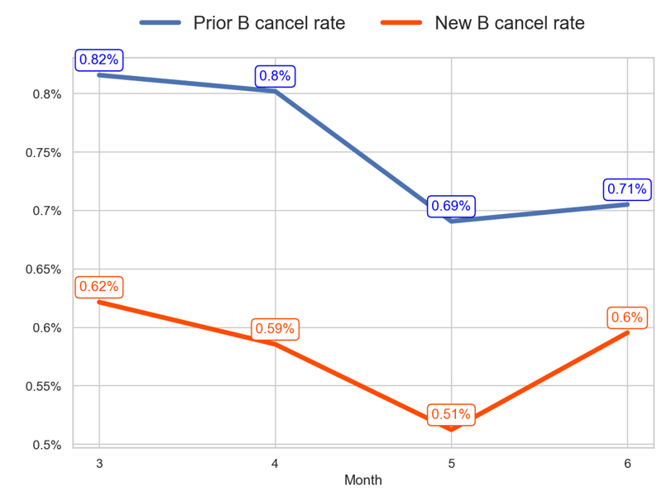
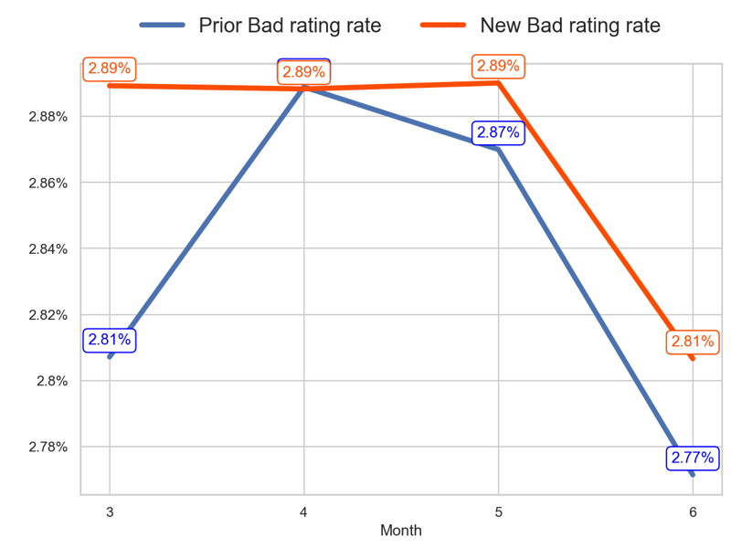
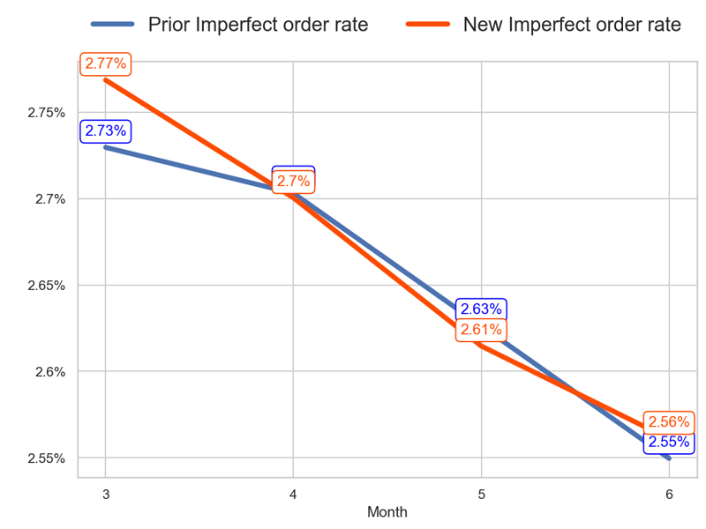
SERVICE
Action Title
Prior P2 vs New P1 -
Insights
- The new priority has a worse tendency than the old one over the last 3 months (-0.03 > -0.11 percentage points) - The last 3 months mean of the old priority is 0.73% and the new priority is 0.56%
- The new priority has a better tendency than the old one over the last 3 months (-0.08 < -0.04 percentage points) - The last 3 months mean of the old priority is 2.84% and the new priority is 2.86%
- The new priority has a worse tendency than the old one over the last 3 months (-0.21 < -0.18 percentage points) - The last 3 months mean of the old priority is 2.63% and the new priority is 2.63%

Slide 3
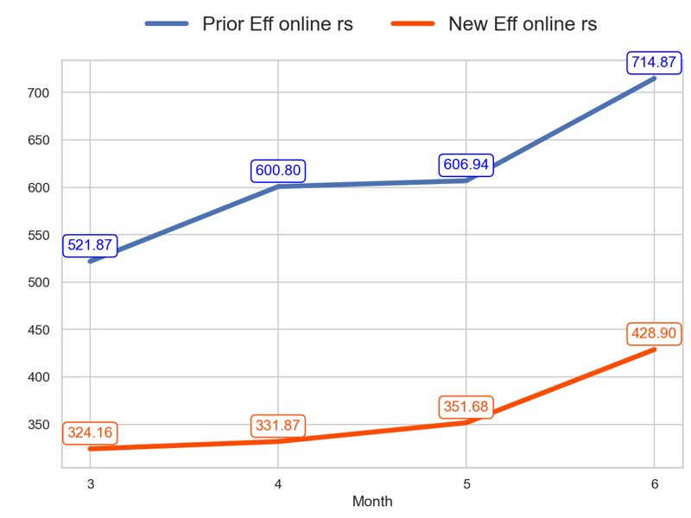
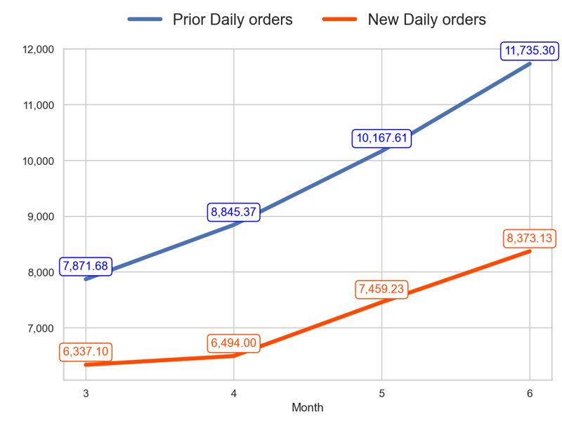
SERVICE
Action Title
Prior P2 vs New P1 -
- The new priority has a worse tendency than the old one over the last 3 months (32.31% < 36.98%) - The last 3 months mean of the old priority is 640.87 and the new priority is 370.81
- The new priority has a worse tendency than the old one over the last 3 months (32.13% < 49.08%) - The last 3 months mean of the old priority is 10249.43 and the new priority is 7442.12

Slide 4
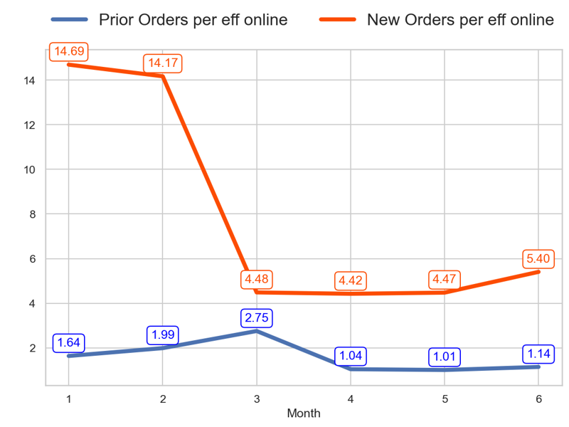
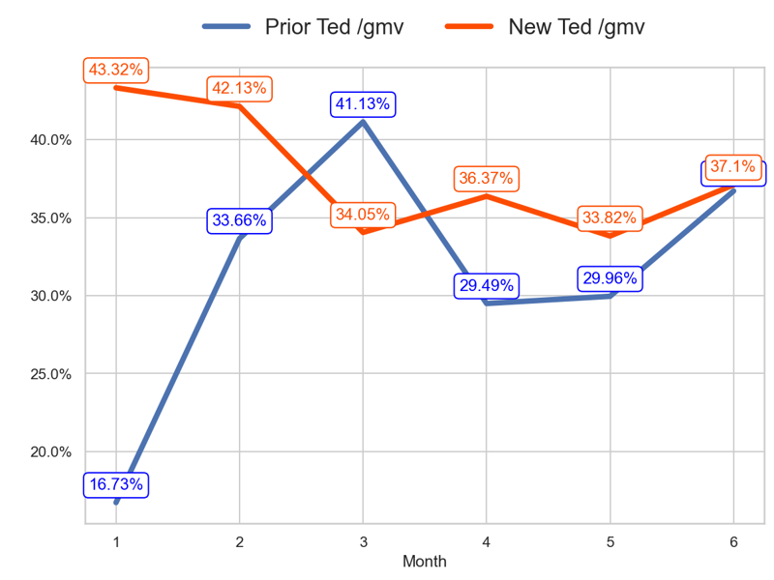
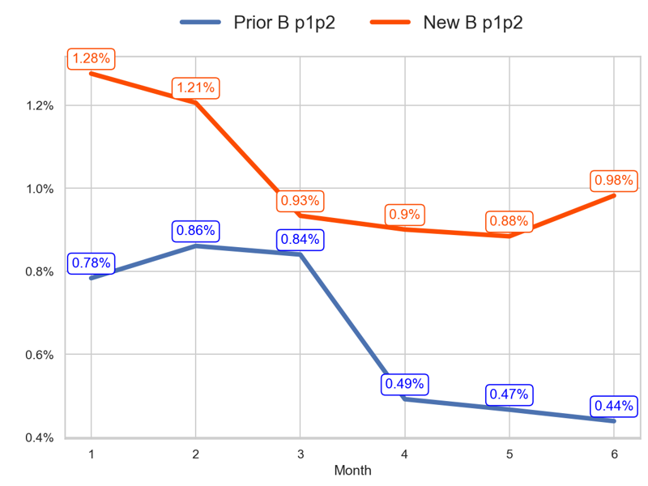
PERFORMANCE
Action Title
Prior P3 vs New P2 -
Insights
- The new priority has a better tendency than the old one over the last 3 months (20.53% > -58.45%) - The last 3 months mean of the old priority is 1.06 and the new priority is 4.77
- The new priority has a better tendency than the old one over the last 3 months (3.05 > -4.43 percentage points) - The last 3 months mean of the old priority is 32.05% and the new priority is 35.76%
- The new priority has a better tendency than the old one over the last 3 months (0.05 > -0.4 percentage points) - The last 3 months mean of the old priority is 0.47% and the new priority is 0.92%

Slide 5
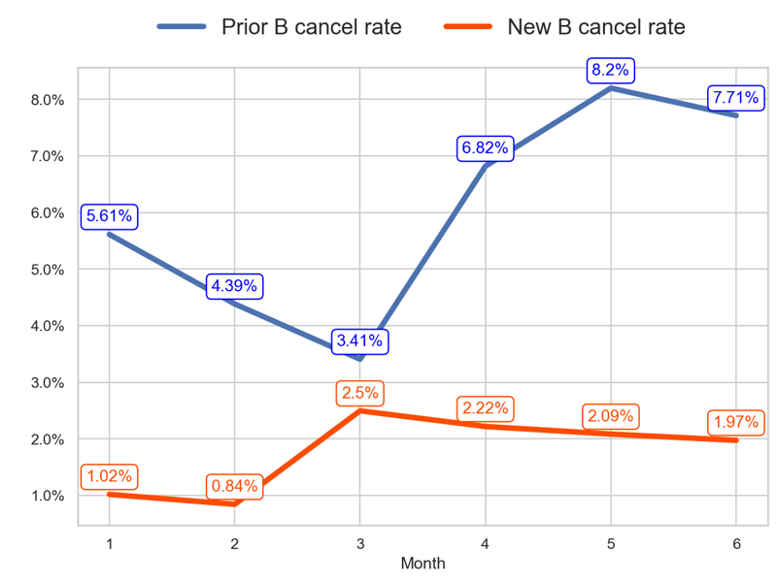
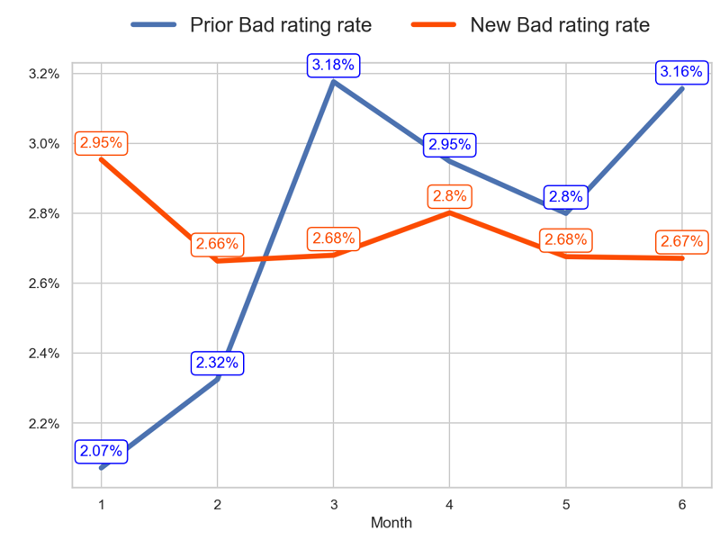
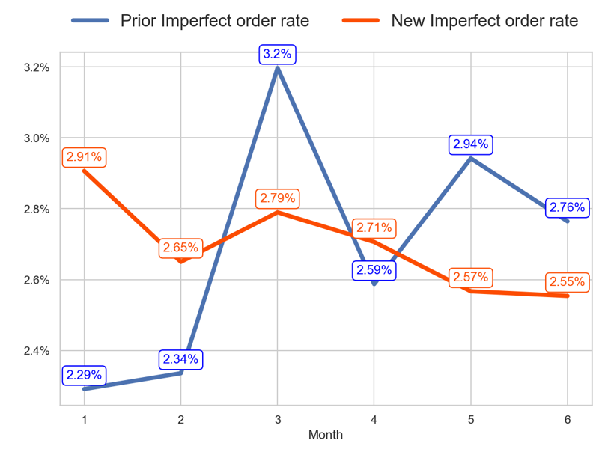
SERVICE
Action Title
Prior P3 vs New P2 -
Insights
- The new priority has a better tendency than the old one over the last 3 months (-0.52 < 4.31 percentage points) - The last 3 months mean of the old priority is 7.58% and the new priority is 2.09%
- The new priority has a worse tendency than the old one over the last 3 months (-0.01 > -0.02 percentage points) - The last 3 months mean of the old priority is 2.97% and the new priority is 2.72%
- The new priority has a better tendency than the old one over the last 3 months (-0.24 > -0.43 percentage points) - The last 3 months mean of the old priority is 2.76% and the new priority is 2.61%

Slide 6
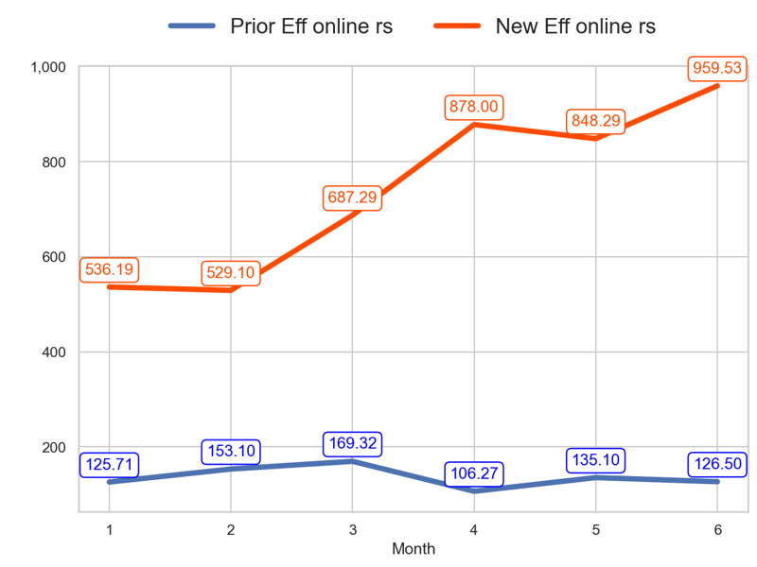
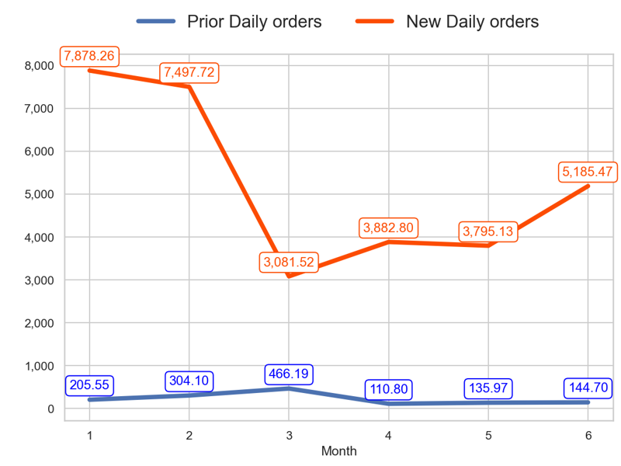
SERVICE
Action Title
Prior P3 vs New P2 -
- The new priority has a better tendency than the old one over the last 3 months (39.61% > -25.29%) - The last 3 months mean of the old priority is 122.62 and the new priority is 895.27
- The new priority has a better tendency than the old one over the last 3 months (68.28% > -68.96%) - The last 3 months mean of the old priority is 130.49 and the new priority is 4287.8

Slide 7
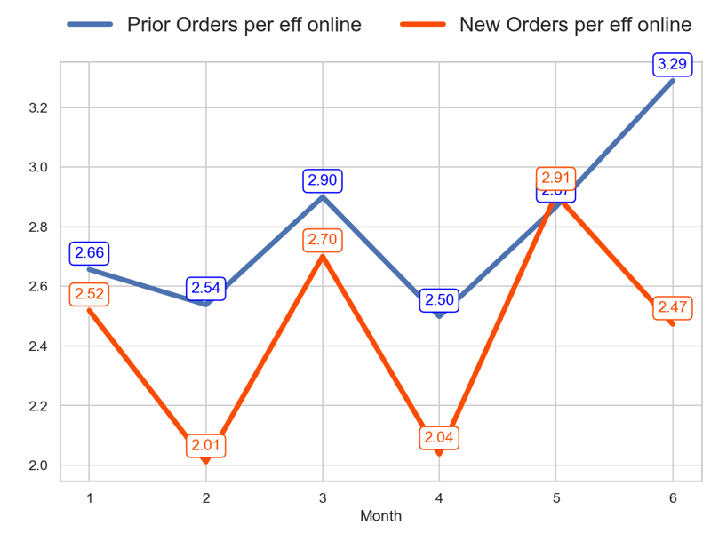
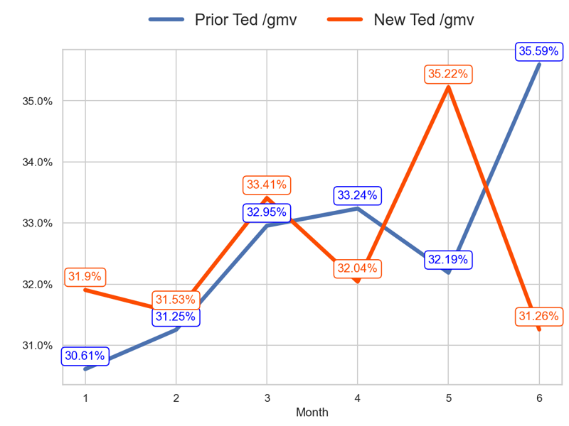
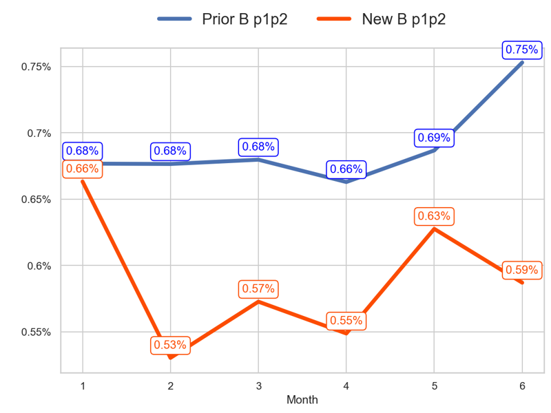
PERFORMANCE
Action Title
Prior P4 vs New P4 -
Insights
- The new priority has a worse tendency than the old one over the last 3 months (-8.42% < 13.46%) - The last 3 months mean of the old priority is 2.88 and the new priority is 2.47
- The new priority has a worse tendency than the old one over the last 3 months (-2.15 < 2.64 percentage points) - The last 3 months mean of the old priority is 33.67% and the new priority is 32.84%
- The new priority has a worse tendency than the old one over the last 3 months (0.01 < 0.07 percentage points) - The last 3 months mean of the old priority is 0.7% and the new priority is 0.59%

Slide 8
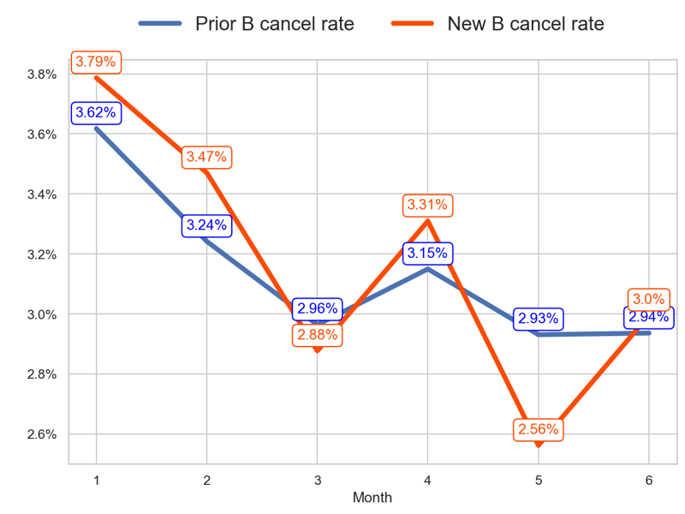
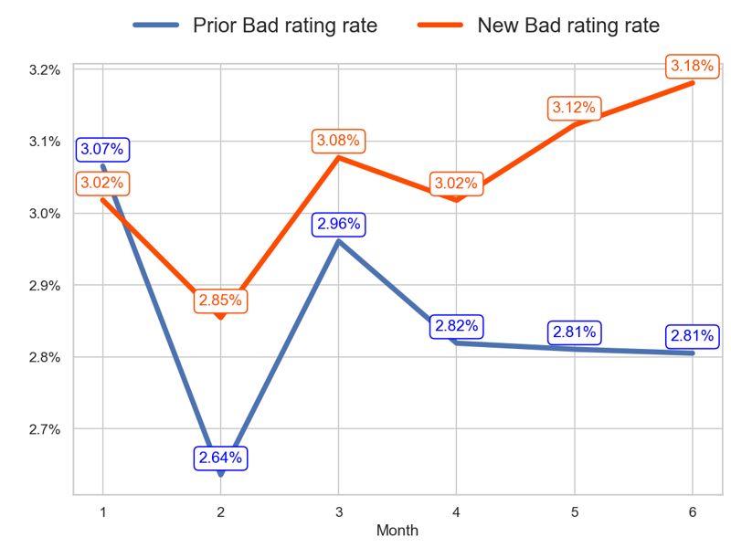
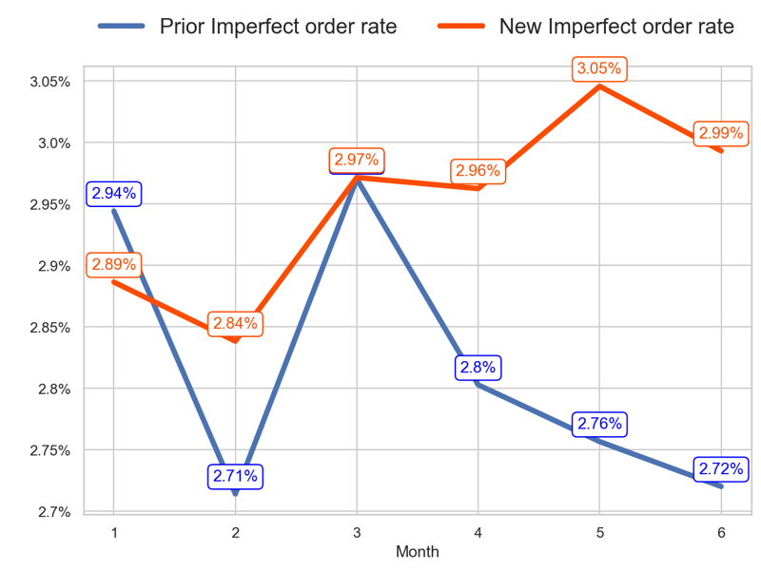
SERVICE
Action Title
Prior P4 vs New P4 -
Insights
- The new priority has a worse tendency than the old one over the last 3 months (0.12 > -0.03 percentage points) - The last 3 months mean of the old priority is 3.01% and the new priority is 2.96%
- The new priority has a worse tendency than the old one over the last 3 months (0.1 > -0.16 percentage points) - The last 3 months mean of the old priority is 2.81% and the new priority is 3.11%
- The new priority has a better tendency than the old one over the last 3 months (0.02 > -0.25 percentage points) - The last 3 months mean of the old priority is 2.76% and the new priority is 3.0%

Slide 9
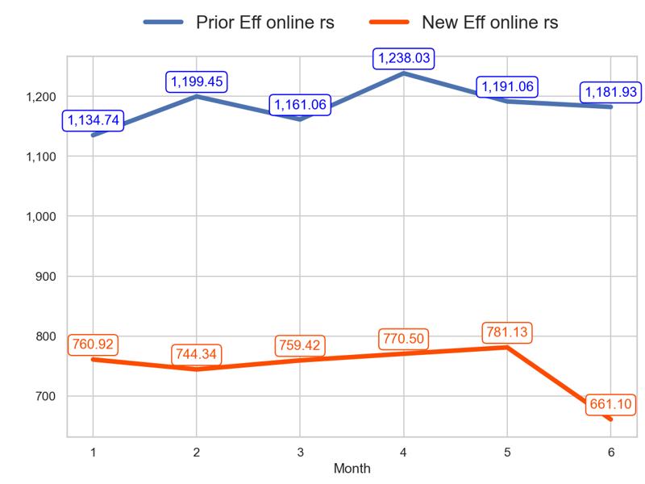
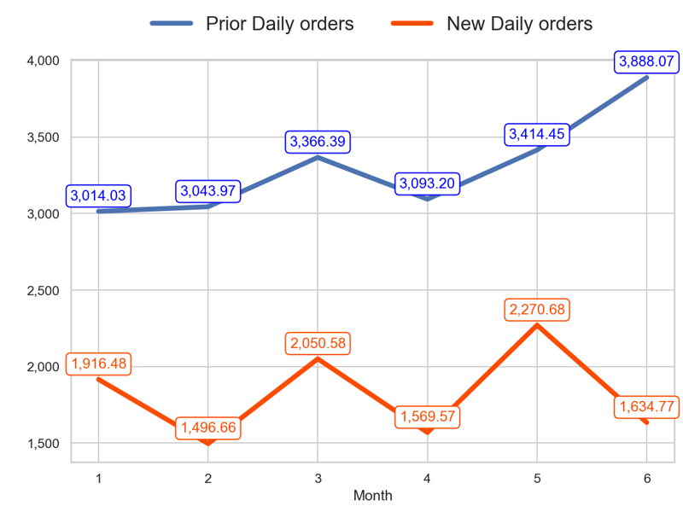
SERVICE
Action Title
Prior P4 vs New P4 -
- The new priority has a worse tendency than the old one over the last 3 months (-12.95% < 1.8%) - The last 3 months mean of the old priority is 1203.68 and the new priority is 737.58
- The new priority has a worse tendency than the old one over the last 3 months (-20.28% < 15.5%) - The last 3 months mean of the old priority is 3465.24 and the new priority is 1825.0

Slide 10
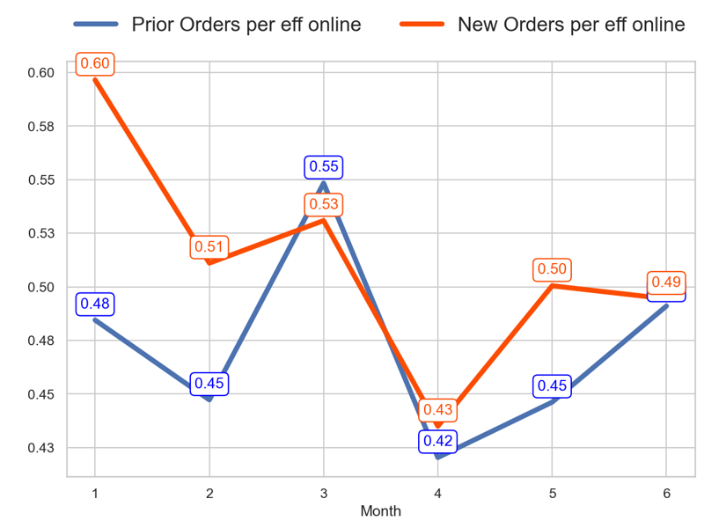
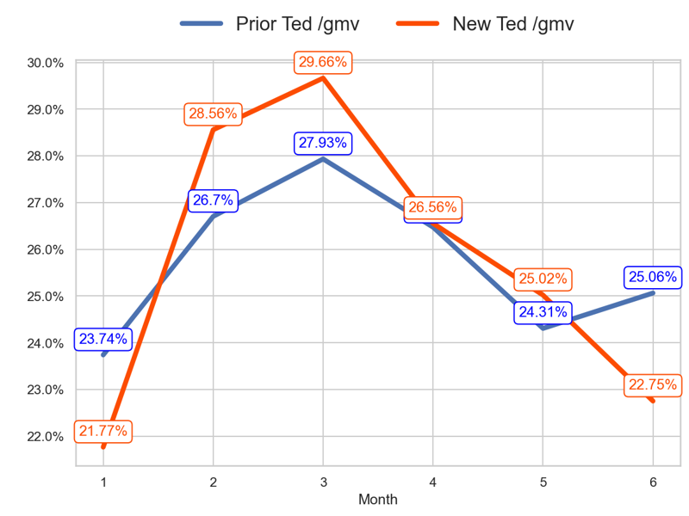
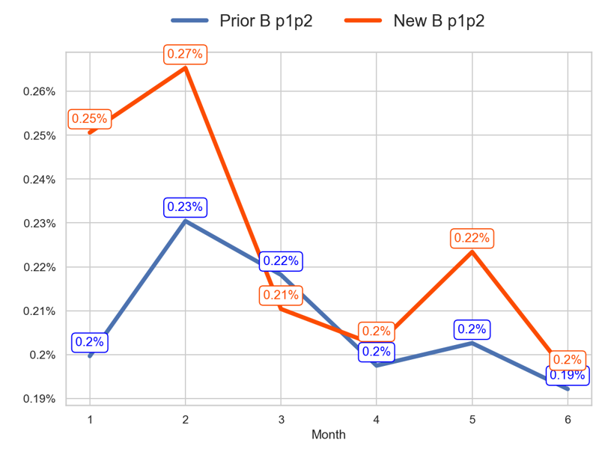
PERFORMANCE
Action Title
Prior P5 vs New P5 -
Insights
- The new priority has a better tendency than the old one over the last 3 months (-6.86% > -10.45%) - The last 3 months mean of the old priority is 0.45 and the new priority is 0.48
- The new priority has a worse tendency than the old one over the last 3 months (-6.91 < -2.87 percentage points) - The last 3 months mean of the old priority is 25.28% and the new priority is 24.78%
- The new priority has a better tendency than the old one over the last 3 months (-0.01 > -0.03 percentage points) - The last 3 months mean of the old priority is 0.2% and the new priority is 0.21%

Slide 11
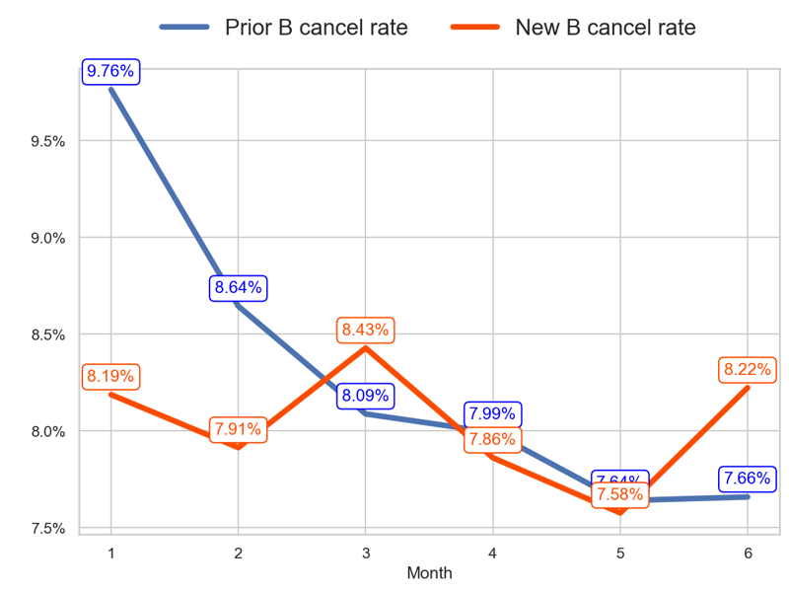
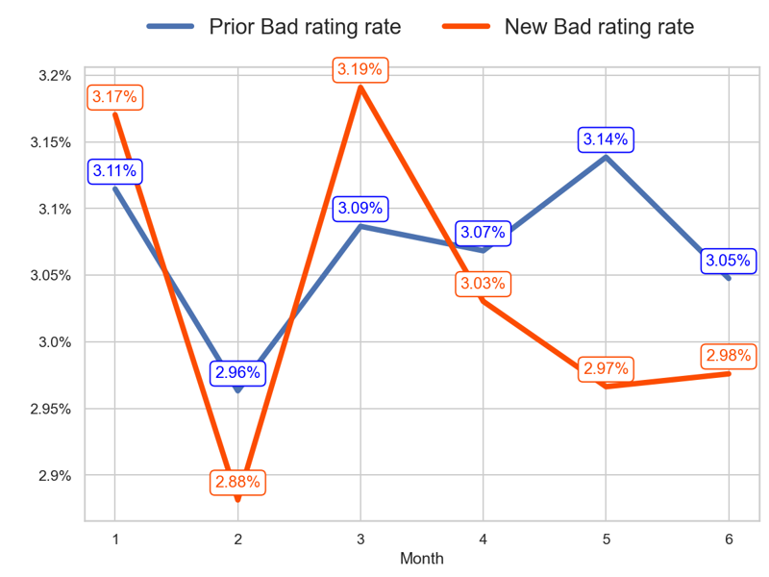
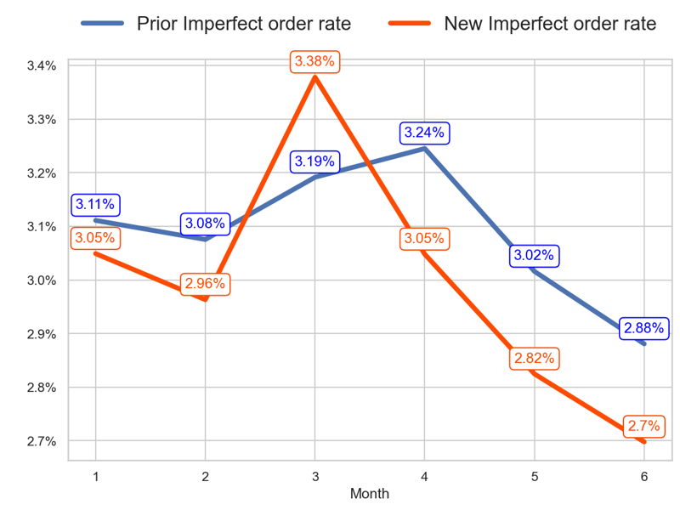
SERVICE
Action Title
Prior P5 vs New P5 -
Insights
- The new priority has a worse tendency than the old one over the last 3 months (-0.21 > -0.43 percentage points) - The last 3 months mean of the old priority is 7.76% and the new priority is 7.89%
- The new priority has a better tendency than the old one over the last 3 months (-0.21 < -0.04 percentage points) - The last 3 months mean of the old priority is 3.08% and the new priority is 2.99%
- The new priority has a worse tendency than the old one over the last 3 months (-0.68 < -0.31 percentage points) - The last 3 months mean of the old priority is 3.05% and the new priority is 2.86%

Slide 12
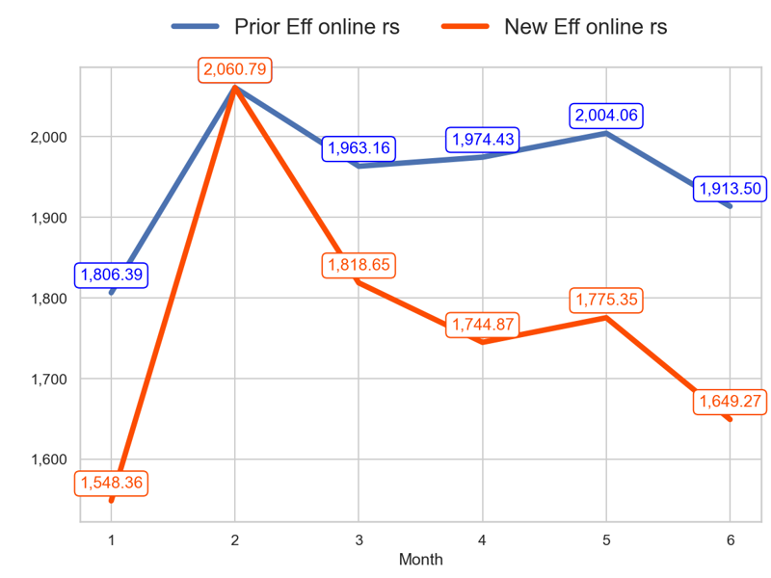
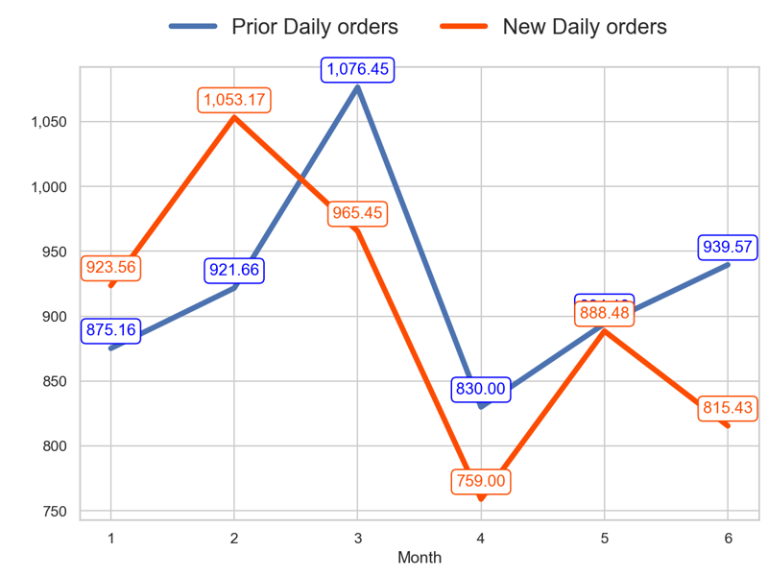
SERVICE
Action Title
Prior P5 vs New P5 -
- The new priority has a worse tendency than the old one over the last 3 months (-9.31% < -2.53%) - The last 3 months mean of the old priority is 1964.0 and the new priority is 1723.16
- The new priority has a worse tendency than the old one over the last 3 months (-15.54% < -12.72%) - The last 3 months mean of the old priority is 887.92 and the new priority is 820.97

Slide 13

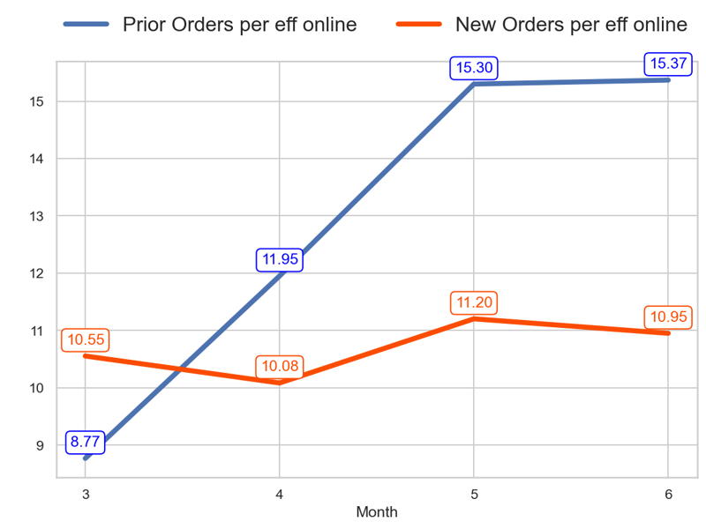
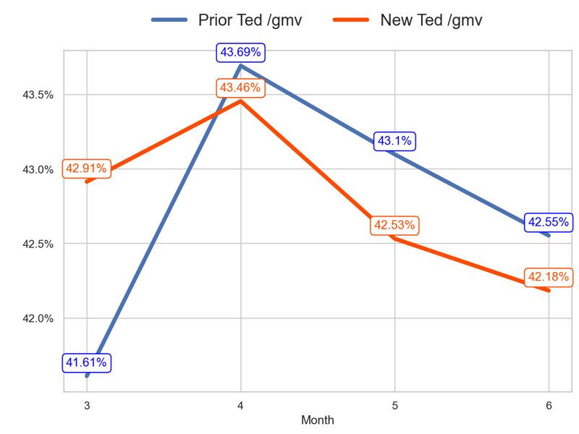
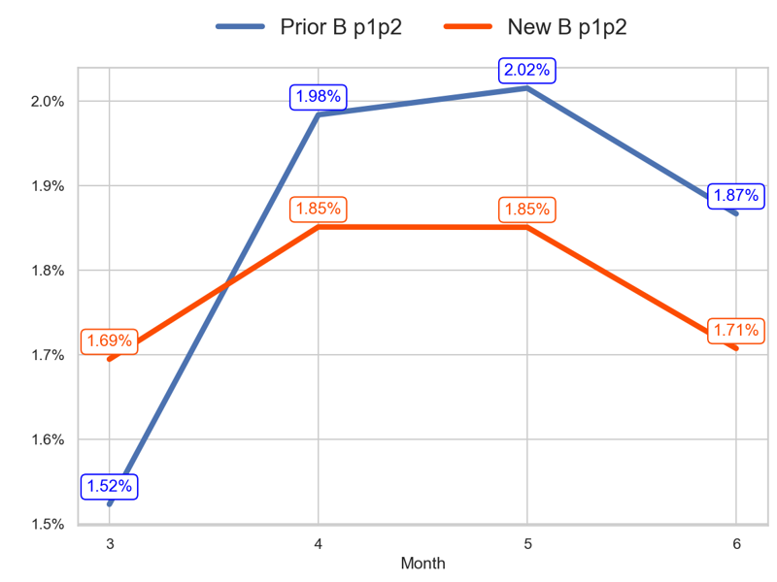
PERFORMANCE
Action Title
Prior P2 vs New P1 -
Insights
- The new priority has a worse tendency than the old one over the last 3 months (3.76% < 75.27%) - The last 3 months mean of the old priority is 14.21 and the new priority is 10.75
- The new priority has a worse tendency than the old one over the last 3 months (-0.73 < 0.94 percentage points) - The last 3 months mean of the old priority is 43.11% and the new priority is 42.72%
- The new priority has a worse tendency than the old one over the last 3 months (0.01 < 0.34 percentage points) - The last 3 months mean of the old priority is 1.95% and the new priority is 1.8%

Slide 14
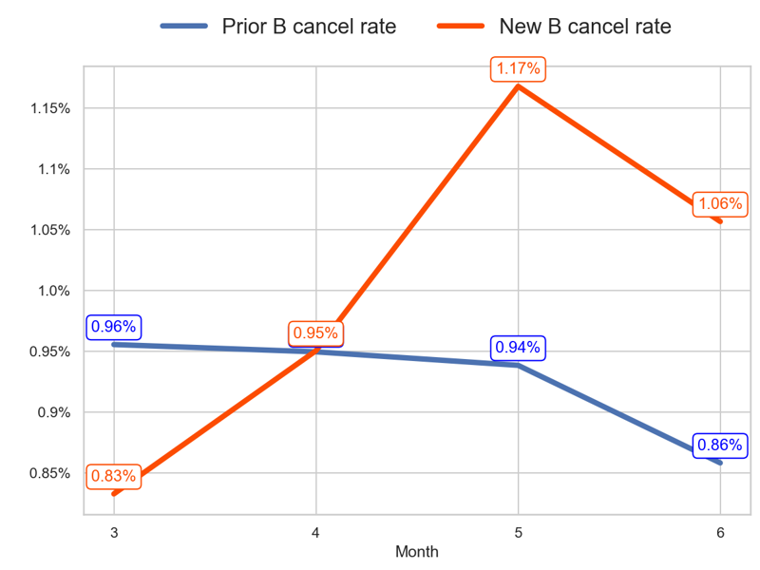
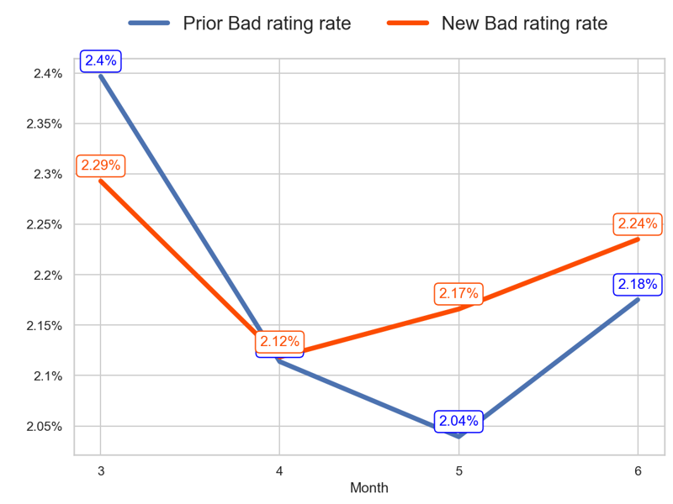
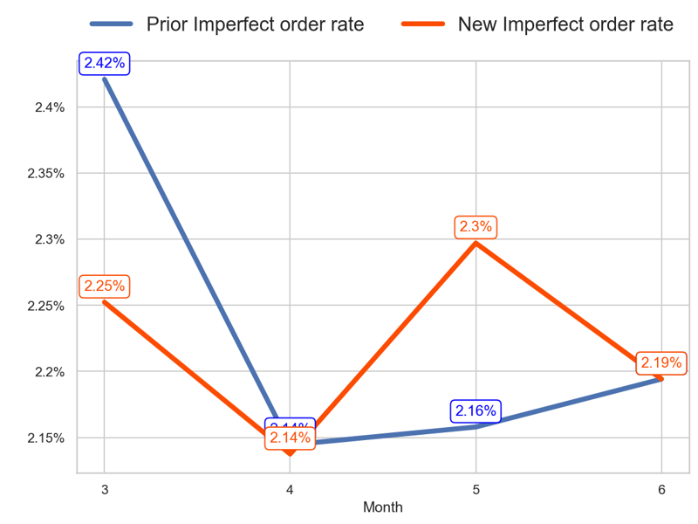
SERVICE
Action Title
Prior P2 vs New P1 -
Insights
- The new priority has a worse tendency than the old one over the last 3 months (0.22 > -0.1 percentage points) - The last 3 months mean of the old priority is 0.92% and the new priority is 1.06%
- The new priority has a worse tendency than the old one over the last 3 months (-0.06 > -0.22 percentage points) - The last 3 months mean of the old priority is 2.11% and the new priority is 2.17%
- The new priority has a better tendency than the old one over the last 3 months (-0.06 > -0.23 percentage points) - The last 3 months mean of the old priority is 2.17% and the new priority is 2.21%

Slide 15
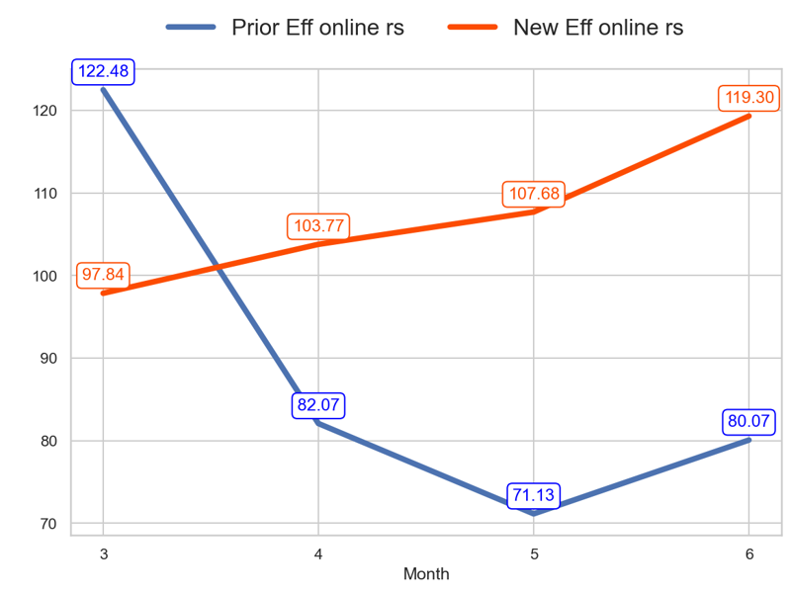
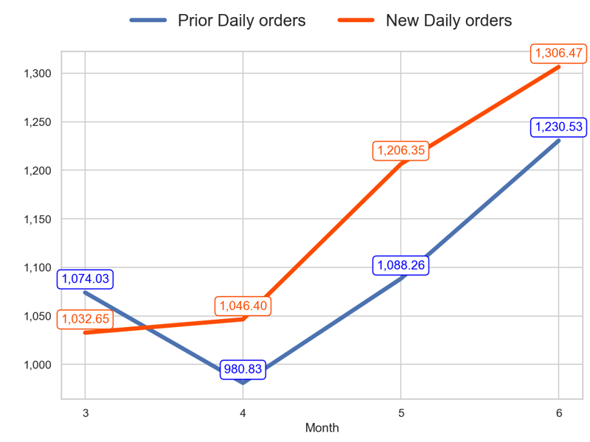
SERVICE
Action Title
Prior P2 vs New P1 -
- The new priority has a better tendency than the old one over the last 3 months (21.94% > -34.63%) - The last 3 months mean of the old priority is 77.75 and the new priority is 110.25
- The new priority has a better tendency than the old one over the last 3 months (26.52% > 14.57%) - The last 3 months mean of the old priority is 1099.87 and the new priority is 1186.41

Slide 16
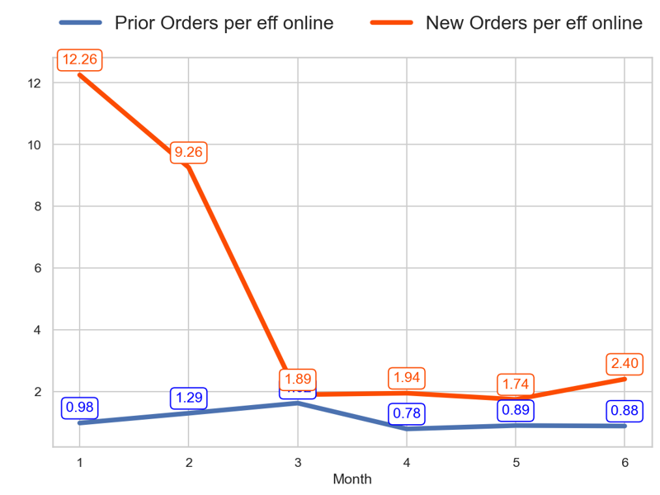
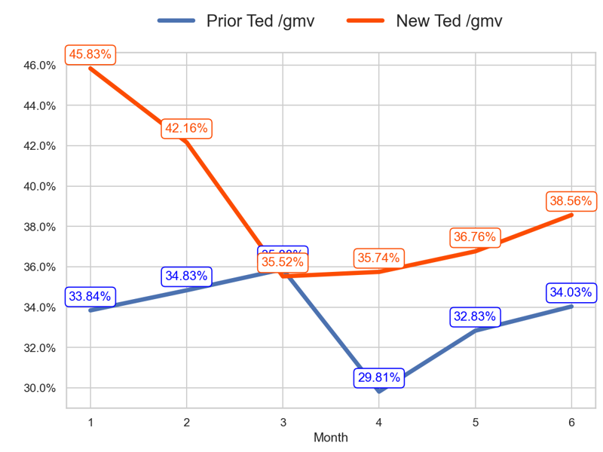
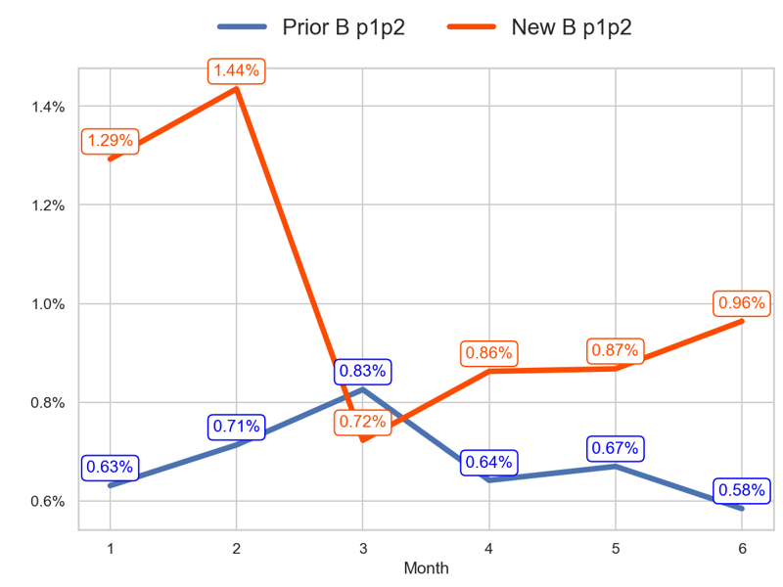
PERFORMANCE
Action Title
Prior P3 vs New P2 -
Insights
- The new priority has a better tendency than the old one over the last 3 months (26.58% > -45.84%) - The last 3 months mean of the old priority is 0.85 and the new priority is 2.03
- The new priority has a better tendency than the old one over the last 3 months (3.04 > -1.85 percentage points) - The last 3 months mean of the old priority is 32.22% and the new priority is 37.02%
- The new priority has a better tendency than the old one over the last 3 months (0.24 > -0.24 percentage points) - The last 3 months mean of the old priority is 0.63% and the new priority is 0.9%

Slide 17
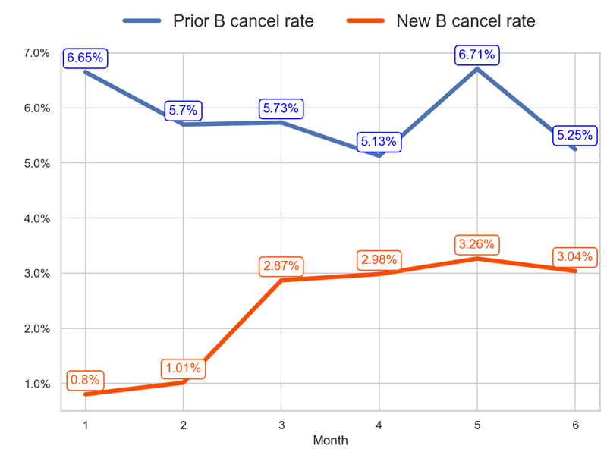
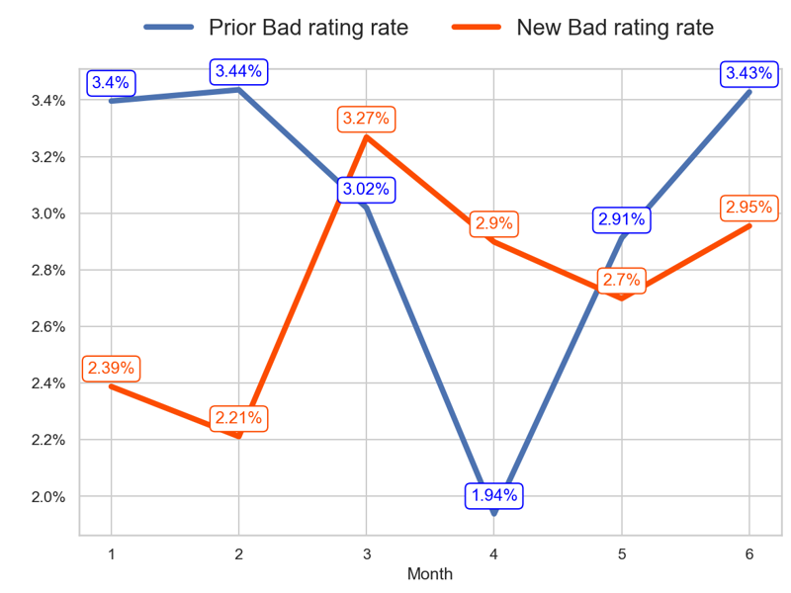
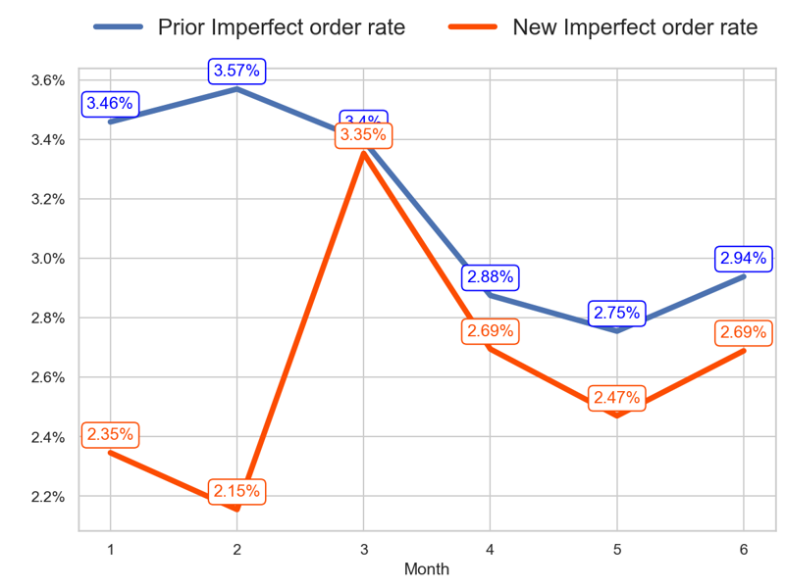
SERVICE
Action Title
Prior P3 vs New P2 -
Insights
- The new priority has a worse tendency than the old one over the last 3 months (0.17 > -0.49 percentage points) - The last 3 months mean of the old priority is 5.69% and the new priority is 3.09%
- The new priority has a better tendency than the old one over the last 3 months (-0.31 < 0.41 percentage points) - The last 3 months mean of the old priority is 2.76% and the new priority is 2.85%
- The new priority has a worse tendency than the old one over the last 3 months (-0.66 < -0.46 percentage points) - The last 3 months mean of the old priority is 2.86% and the new priority is 2.62%

Slide 18
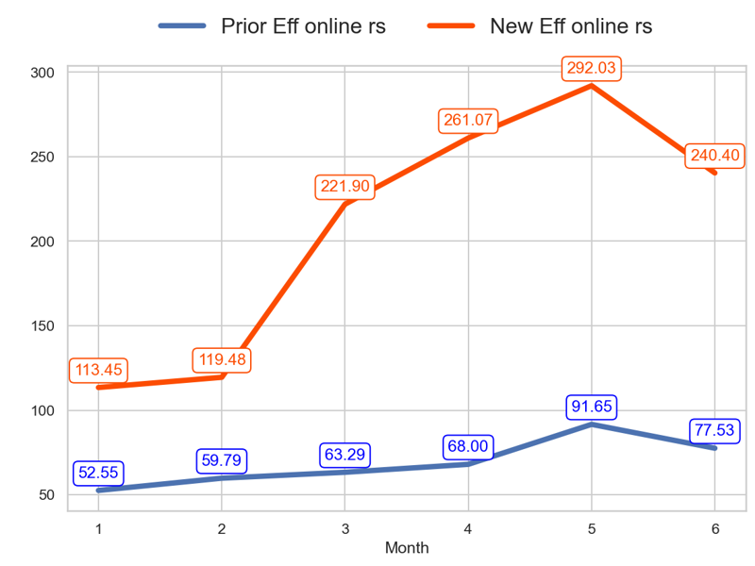
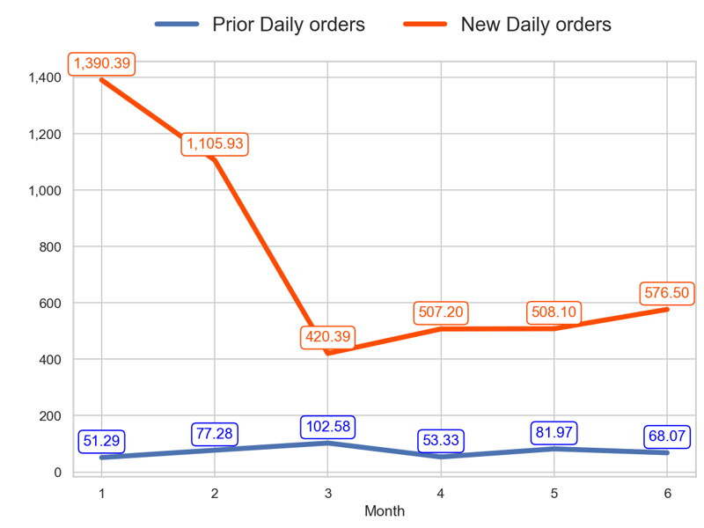
SERVICE
Action Title
Prior P3 vs New P2 -
- The new priority has a worse tendency than the old one over the last 3 months (8.34% < 22.5%) - The last 3 months mean of the old priority is 79.06 and the new priority is 264.5
- The new priority has a better tendency than the old one over the last 3 months (37.14% > -33.65%) - The last 3 months mean of the old priority is 67.79 and the new priority is 530.6

Slide 19
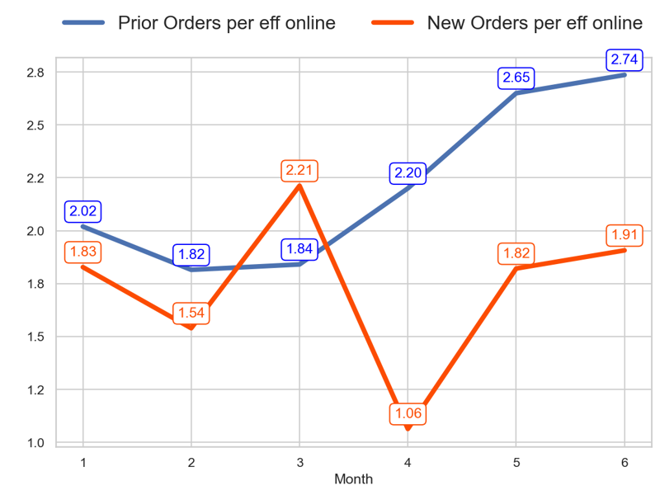
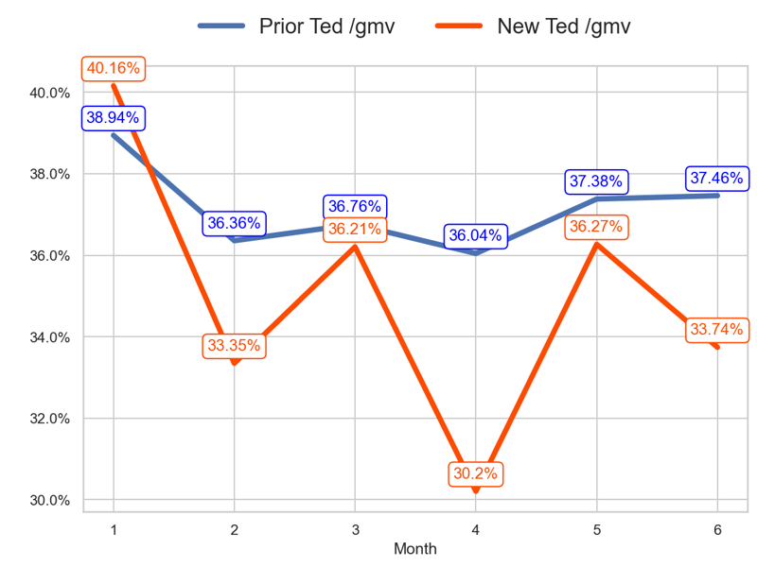

PERFORMANCE
Action Title
Prior P4 vs New P4 -
Insights
- The new priority has a worse tendency than the old one over the last 3 months (-13.8% < 48.64%) - The last 3 months mean of the old priority is 2.53 and the new priority is 1.6
- The new priority has a worse tendency than the old one over the last 3 months (-2.47 < 0.7 percentage points) - The last 3 months mean of the old priority is 36.96% and the new priority is 33.4%
- The new priority has a worse tendency than the old one over the last 3 months (0.03 < 0.28 percentage points) - The last 3 months mean of the old priority is 0.9% and the new priority is 0.62%

Slide 20



SERVICE
Action Title
Prior P4 vs New P4 -
Insights
- The new priority has a better tendency than the old one over the last 3 months (-0.38 < 0.1 percentage points) - The last 3 months mean of the old priority is 2.57% and the new priority is 2.73%
- The new priority has a worse tendency than the old one over the last 3 months (0.14 > -0.08 percentage points) - The last 3 months mean of the old priority is 2.81% and the new priority is 2.82%
- The new priority has a better tendency than the old one over the last 3 months (-0.07 > -0.28 percentage points) - The last 3 months mean of the old priority is 2.68% and the new priority is 2.91%

Slide 21


SERVICE
Action Title
Prior P4 vs New P4 -
- The new priority has a worse tendency than the old one over the last 3 months (-15.14% < -11.38%) - The last 3 months mean of the old priority is 281.81 and the new priority is 106.5
- The new priority has a worse tendency than the old one over the last 3 months (-26.86% < 31.72%) - The last 3 months mean of the old priority is 711.34 and the new priority is 164.43

Slide 22



PERFORMANCE
Action Title
Prior P5 vs New P5 -
Insights
- The new priority has a worse tendency than the old one over the last 3 months (-10.42% < 1.97%) - The last 3 months mean of the old priority is 0.33 and the new priority is 0.31
- The new priority has a worse tendency than the old one over the last 3 months (-3.67 < -1.12 percentage points) - The last 3 months mean of the old priority is 24.76% and the new priority is 23.19%
- The new priority has a worse tendency than the old one over the last 3 months (0.04 < 0.07 percentage points) - The last 3 months mean of the old priority is 0.2% and the new priority is 0.19%

Slide 23



SERVICE
Action Title
Prior P5 vs New P5 -
Insights
- The new priority has a better tendency than the old one over the last 3 months (-0.45 < -0.18 percentage points) - The last 3 months mean of the old priority is 5.64% and the new priority is 5.89%
- The new priority has a better tendency than the old one over the last 3 months (-0.1 < 0.06 percentage points) - The last 3 months mean of the old priority is 3.12% and the new priority is 3.01%
- The new priority has a worse tendency than the old one over the last 3 months (-0.03 < -0.02 percentage points) - The last 3 months mean of the old priority is 2.86% and the new priority is 2.95%

Slide 24


SERVICE
Action Title
Prior P5 vs New P5 -
- The new priority has a worse tendency than the old one over the last 3 months (-6.88% < 0.91%) - The last 3 months mean of the old priority is 848.54 and the new priority is 717.86
- The new priority has a worse tendency than the old one over the last 3 months (-16.58% < 2.9%) - The last 3 months mean of the old priority is 278.17 and the new priority is 219.76

Slide 25




PERFORMANCE
Action Title
Prior P2 vs New P1 -
Insights
- The new priority has a worse tendency than the old one over the last 3 months (9.81% < 10.81%) - The last 3 months mean of the old priority is 14.03 and the new priority is 14.96
- The new priority has a better tendency than the old one over the last 3 months (5.7 > 4.85 percentage points) - The last 3 months mean of the old priority is 29.65% and the new priority is 30.25%
- The new priority has a worse tendency than the old one over the last 3 months (0.21 < 0.21 percentage points) - The last 3 months mean of the old priority is 1.68% and the new priority is 1.74%

Slide 26



SERVICE
Action Title
Prior P2 vs New P1 -
Insights
- The new priority has a worse tendency than the old one over the last 3 months (-0.24 > -0.28 percentage points) - The last 3 months mean of the old priority is 0.78% and the new priority is 0.71%
- The new priority has a better tendency than the old one over the last 3 months (-0.04 < 0.13 percentage points) - The last 3 months mean of the old priority is 2.14% and the new priority is 2.13%
- The new priority has a worse tendency than the old one over the last 3 months (-0.32 < -0.1 percentage points) - The last 3 months mean of the old priority is 2.01% and the new priority is 1.98%

Slide 27


SERVICE
Action Title
Prior P2 vs New P1 -
- The new priority has a worse tendency than the old one over the last 3 months (2.24% < 11.6%) - The last 3 months mean of the old priority is 93.17 and the new priority is 80.55
- The new priority has a worse tendency than the old one over the last 3 months (12.27% < 23.66%) - The last 3 months mean of the old priority is 1306.64 and the new priority is 1200.95

Slide 28



PERFORMANCE
Action Title
Prior P3 vs New P2 -
Insights
- The new priority has a better tendency than the old one over the last 3 months (2.08% > -30.04%) - The last 3 months mean of the old priority is 0.93 and the new priority is 3.07
- The new priority has a better tendency than the old one over the last 3 months (2.92 > 0.57 percentage points) - The last 3 months mean of the old priority is 19.15% and the new priority is 23.49%
- The new priority has a better tendency than the old one over the last 3 months (0.04 > -0.16 percentage points) - The last 3 months mean of the old priority is 0.59% and the new priority is 0.99%

Slide 29



SERVICE
Action Title
Prior P3 vs New P2 -
Insights
- The new priority has a better tendency than the old one over the last 3 months (-0.87 < -0.08 percentage points) - The last 3 months mean of the old priority is 7.81% and the new priority is 2.73%
- The new priority has a worse tendency than the old one over the last 3 months (0.06 > -1.4 percentage points) - The last 3 months mean of the old priority is 1.75% and the new priority is 2.39%
- The new priority has a better tendency than the old one over the last 3 months (-0.01 > -1.11 percentage points) - The last 3 months mean of the old priority is 1.91% and the new priority is 2.5%

Slide 30


SERVICE
Action Title
Prior P3 vs New P2 -
- The new priority has a better tendency than the old one over the last 3 months (19.85% > 7.43%) - The last 3 months mean of the old priority is 25.45 and the new priority is 163.81
- The new priority has a better tendency than the old one over the last 3 months (22.34% > -24.84%) - The last 3 months mean of the old priority is 23.57 and the new priority is 503.23

Slide 31



PERFORMANCE
Action Title
Prior P4 vs New P4 -
Insights
- The new priority has a worse tendency than the old one over the last 3 months (-18.3% < -6.03%) - The last 3 months mean of the old priority is 2.46 and the new priority is 1.75
- The new priority has a worse tendency than the old one over the last 3 months (-0.78 < 2.73 percentage points) - The last 3 months mean of the old priority is 22.02% and the new priority is 18.3%
- The new priority has a worse tendency than the old one over the last 3 months (-0.0 < 0.03 percentage points) - The last 3 months mean of the old priority is 0.8% and the new priority is 0.61%

Slide 32



SERVICE
Action Title
Prior P4 vs New P4 -
Insights
- The new priority has a worse tendency than the old one over the last 3 months (-0.19 > -0.28 percentage points) - The last 3 months mean of the old priority is 2.61% and the new priority is 2.48%
- The new priority has a better tendency than the old one over the last 3 months (-0.32 < -0.27 percentage points) - The last 3 months mean of the old priority is 2.4% and the new priority is 2.3%
- The new priority has a better tendency than the old one over the last 3 months (-0.11 > -0.33 percentage points) - The last 3 months mean of the old priority is 2.43% and the new priority is 2.3%

Slide 33


SERVICE
Action Title
Prior P4 vs New P4 -
- The new priority has a worse tendency than the old one over the last 3 months (-4.83% < -3.22%) - The last 3 months mean of the old priority is 266.36 and the new priority is 151.48
- The new priority has a worse tendency than the old one over the last 3 months (-22.24% < -9.05%) - The last 3 months mean of the old priority is 654.08 and the new priority is 265.25

Slide 34



PERFORMANCE
Action Title
Prior P5 vs New P5 -
Insights
- The new priority has a better tendency than the old one over the last 3 months (-10.36% > -46.94%) - The last 3 months mean of the old priority is 0.36 and the new priority is 0.36
- The new priority has a better tendency than the old one over the last 3 months (-0.35 > -9.05 percentage points) - The last 3 months mean of the old priority is 14.44% and the new priority is 13.86%
- The new priority has a better tendency than the old one over the last 3 months (-0.02 > -0.12 percentage points) - The last 3 months mean of the old priority is 0.21% and the new priority is 0.2%

Slide 35



SERVICE
Action Title
Prior P5 vs New P5 -
Insights
- The new priority has a better tendency than the old one over the last 3 months (0.22 < 2.81 percentage points) - The last 3 months mean of the old priority is 7.61% and the new priority is 8.06%
- The new priority has a worse tendency than the old one over the last 3 months (-0.31 > -0.31 percentage points) - The last 3 months mean of the old priority is 2.76% and the new priority is 2.8%
- The new priority has a worse tendency than the old one over the last 3 months (-0.5 < -0.07 percentage points) - The last 3 months mean of the old priority is 3.04% and the new priority is 2.95%

Slide 36


SERVICE
Action Title
Prior P5 vs New P5 -
- The new priority has a worse tendency than the old one over the last 3 months (-19.53% < 5.21%) - The last 3 months mean of the old priority is 554.46 and the new priority is 452.8
- The new priority has a better tendency than the old one over the last 3 months (-27.86% > -44.18%) - The last 3 months mean of the old priority is 199.88 and the new priority is 162.57

